Slide 1

Atharva college of engineering Circumferential Reporting system
Date of Presentation:
21/05/21
Guided by:
Prof. Suchetadevi Gaikwad
Team Members:
Abhijit Turate-70
Priyanka Shinde-71
Kesha Mehta-74

Slide 2
INDEX
Introduction
Problem statement
Aim and Objective
Literature Review
Components
Block Diagram
Circuit Diagram
Result
Conclusion
References

Slide 3
INTRODUCTION
Circumferential reporting system will mainly be useful at chemical manufacturing plants and to check conditions for outdoor activities.
It will use MQ2 gas sensor which detects gases like methane, butane, LPG and smoke. In case of any type of gas leakage or any combustion related to a leak will be detected by a temperature sensor. The photoresistor can be used to indicate the presence of a fire.
For people who wish to check the quality of air present in nearby area or check the outside condition will be also able to use this system.

Slide 4
Problem Statement:
At present as the use of toxic gases in industry increases, the number of accidents that occur also increases. This system is made to detect accidents at an early stage to prevent them from causing any harm. This system also aims at people who wish to check the quality of air present in nearby area or check the outside condition with a cost effective and a sustainable system.

Slide 5
Aim and Objective
The main objective is to develop a sustainable circumferential reporting system.
This project can perform well in chemical manufacturing plants situation as the range of the device will be confined to a particular space only.
Cost effective as it uses multiple sensors and a microcontroller board which are usually cheap.
Easy to assemble.
Easy to develop algorithm to respond to anomaly.

Slide 6
Literature Review:
Sr No: | Title | Author | Publication | Approach
1. | Smart weather monitoring and real time alert system using IoT | Yashaswi Rahut , Rimsha Afreen, Divya Kamini | IJERT | The system proposed is an advanced solution for weather monitoring that uses IoT to make its real time data easily accessible over a very wide range.
2. | IOT Based Weather Monitoring and Reporting System Project | Anita M. Bhagat, Ashwini G. Thakare, Kajal A. Molke, Neha S. Muneshwar, Prof. V. Choudhary | IJTSRD | The IOT based Weather Monitoring and Reporting System project is used to get Live reporting of weather conditions.
3. | IOT based weather reporting system to find dynamic climatic parameters | Kavya Ladi, A V S N Manoj, G V N Deepak. | IEEE | Now-a-days many weather reporting applications are available which gives us information about climatic changes that are going to take place by which man can be aware of present and future climatic changes.

Slide 7
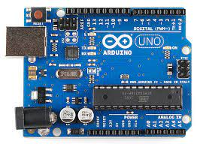
Components:
Controller
Arduino Controller

Slide 8
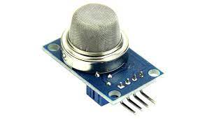
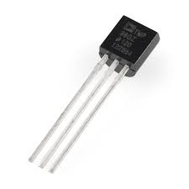
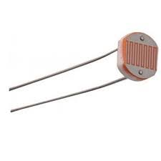
Sensors Gas Sensor TMP-36 Photoresistor Sensor

Slide 9
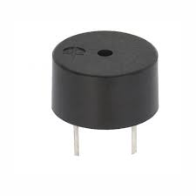
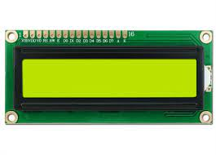
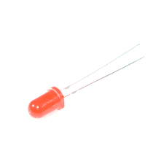
Output Devices: Buzzer LCD LED

Slide 10
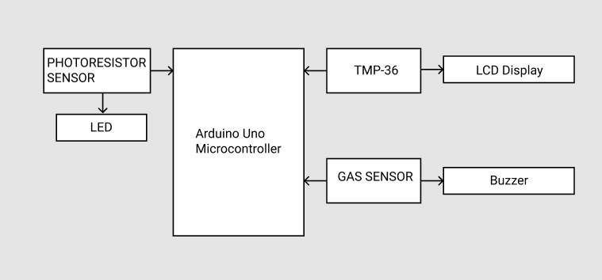
Block Diagram

Slide 11
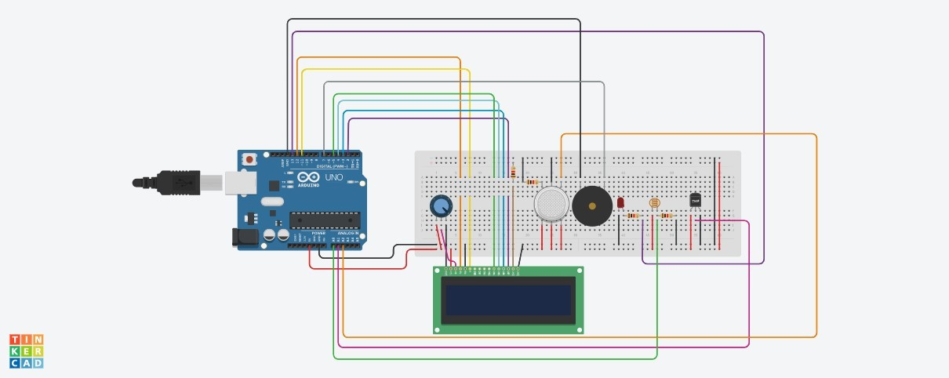
Circuit Diagram

Slide 12
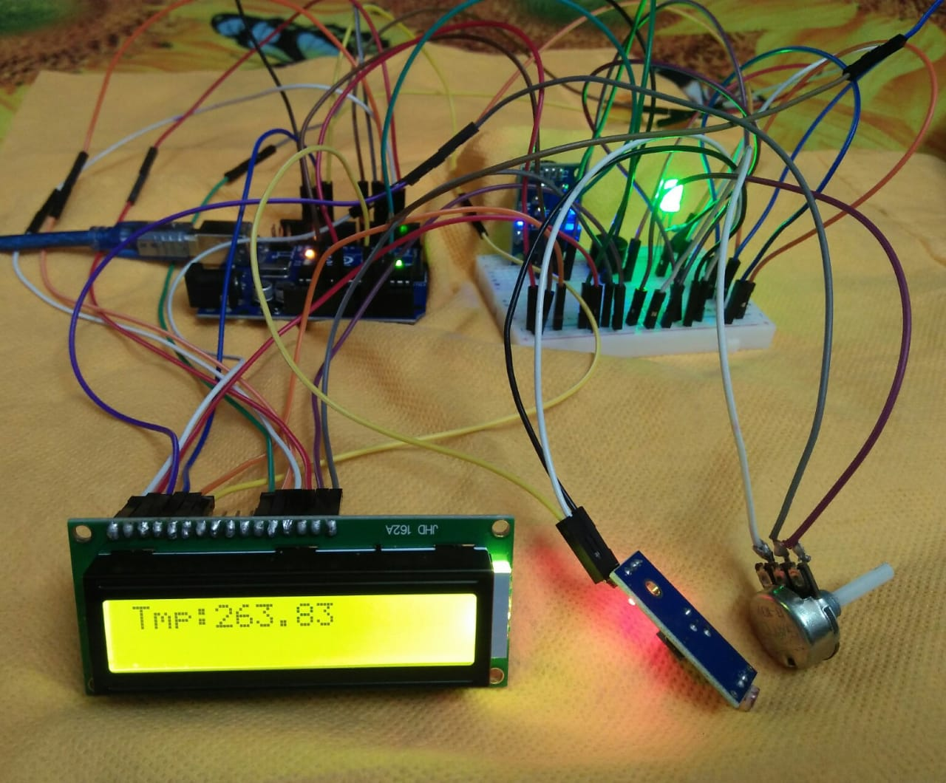
Implementation

Slide 13
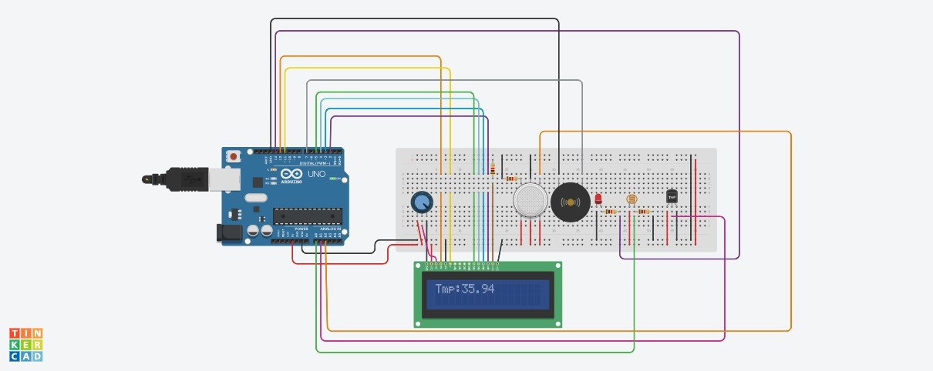
Result
As it can be concluded from the picture, the system has been designed and tested successfully in a successful manner. Also, functionality of the system, as well as the overall behavior of the circuit, has been observed and the results were great as expected and desired.

Slide 14
Conclusion
We built an efficient Circumferential Reporting System which can be used to detect gases and monitor the level of temperature around.
This system assures the reporting of outside temperature to point. This data can be further used to display the type of day it is and also its temperature.
It ultimately helps to keep in the society as it is cost affective. Therefore, Circumferential reporting system is very effective.

Slide 15
References:
K. Ladi, A. V. S. N. Manoj and G. V. N. Deepak, "IOT based weather reporting system to find dynamic climatic parameters," 2017 International Conference on Energy, Communication, Data Analytics and Soft Computing (ICECDS), 2017, pp. 2509-2513, doi: 10.1109/ICECDS.2017.8389904.
Yashaswi Rahut 1, Rimsha Afreen2, Divya Kamini, “Smart weather monitoring and real time alert system using IoT” International Research Journal of Engineering and Technology (IRJET) e-ISSN: 2395-0056 Volume: 05 Issue: 10 | Oct 2018 www.irjet.net p-ISSN: 2395-0072
Anita M. Bhagat, Ashwini G. Thakare, Kajal A. Molke, Neha S. Muneshwar, Prof. V. Choudhary "IOT Based Weather Monitoring and Reporting System Project" Published in International Journal of Trend in Scientific Research and Development (ijtsrd), ISSN: 2456- 6470, Volume-3 | Issue-3, April 2019, pp.365-367
rps://www.researchgate.net/publication/333698819_IOT_Based_Weathe_Monitoring_and_Reporting_System_Project/fulltext/5cffb14b299bf13a384cab8a/IOT-Based-Weather-Monitoring-and-Reporting-System-Project.pdf
https://electronicsclub.info/breadboard.htm

Slide 16
THANKYOU

